Slide 1
Monday, 07-09- 2026
Grade: 1
Section: A, B, C, D, E
Lesson Title : Topic: Understand Addition and Subtraction
Lesson1-2 Put Together

Slide 2

Date:07.09.2026
5min
LOOK → THINK → SHARE
Look at the flag.
• Which country Flag is this?
• How Many Colors do you see?
• Which Colors do you see?
RED
WHITE
GREEN
BLACK
We will use UAE colors in our Maths model today.

Slide 3
2 min
Date:07.09.2026
Standards:1.OA.A.1 — Use addition and subtraction within 20 to solve word problems involving situations of putting together, with unknowns in all positions.
MP.2—Reason Abstractly and Quantitatively
Students represent word problems using equations and explain what the quantities mean.
Learning Objective:
I Can Show how two parts can make a whole.
Success Criteria :
ALL: I can find the two parts.
MOST: I can put the parts together to find the whole.
SOME: I can show my thinking with cubes or a picture, and explain how I found the whole.

Slide 4
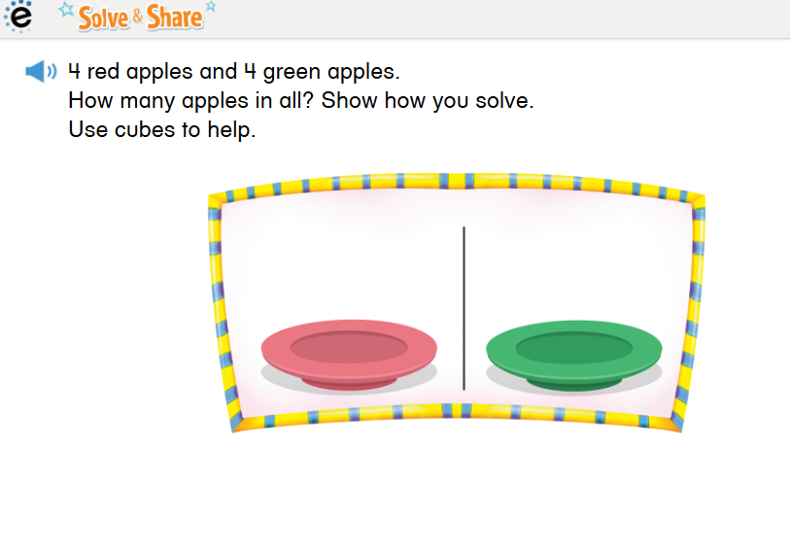
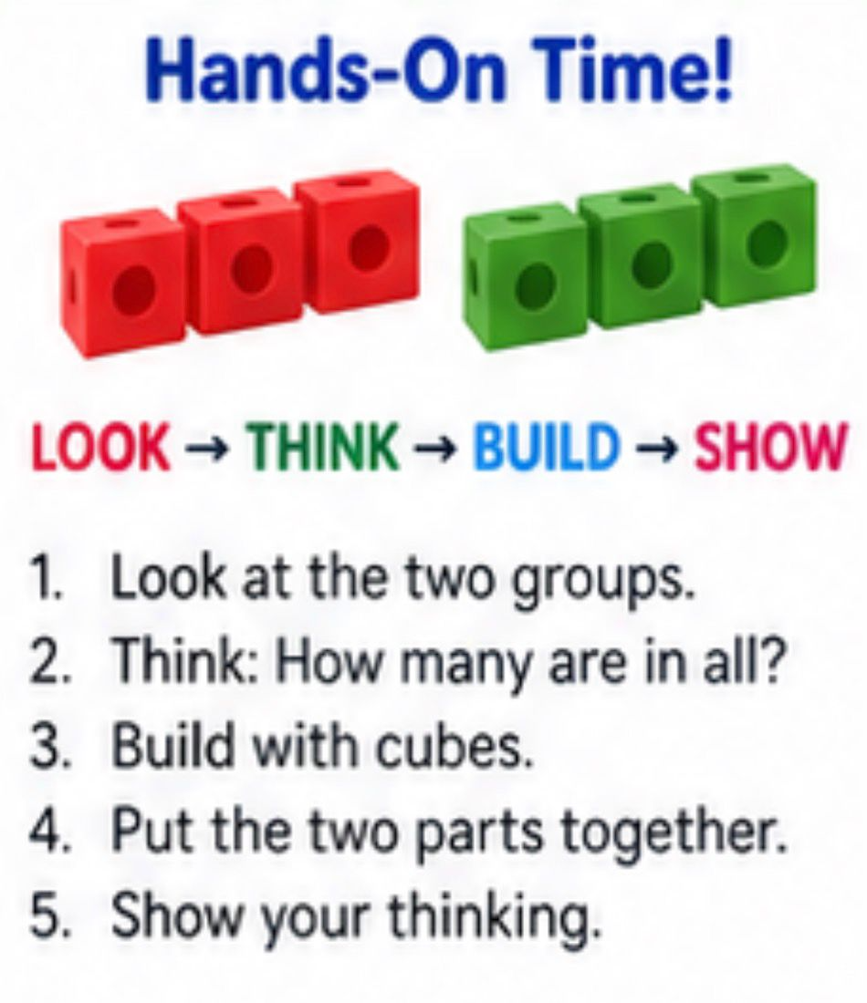
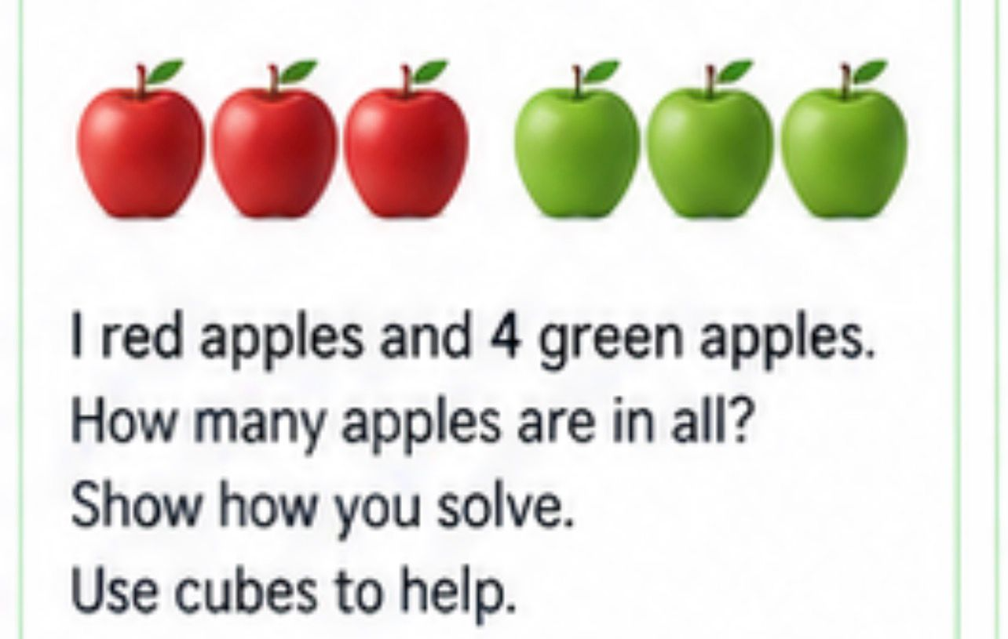
10min
Savvas Solve & Share • Student Book p. 9
Look at the two groups.
Think: What are the two groups?
Build with connecting cubes.
Put the groups together.
Find how many apples are in all.
Show your thinking.

Slide 5

Savvas Visual Learning Bridge • Student Book p. 10 8min
WATCH → LOOK → THINK

Slide 6
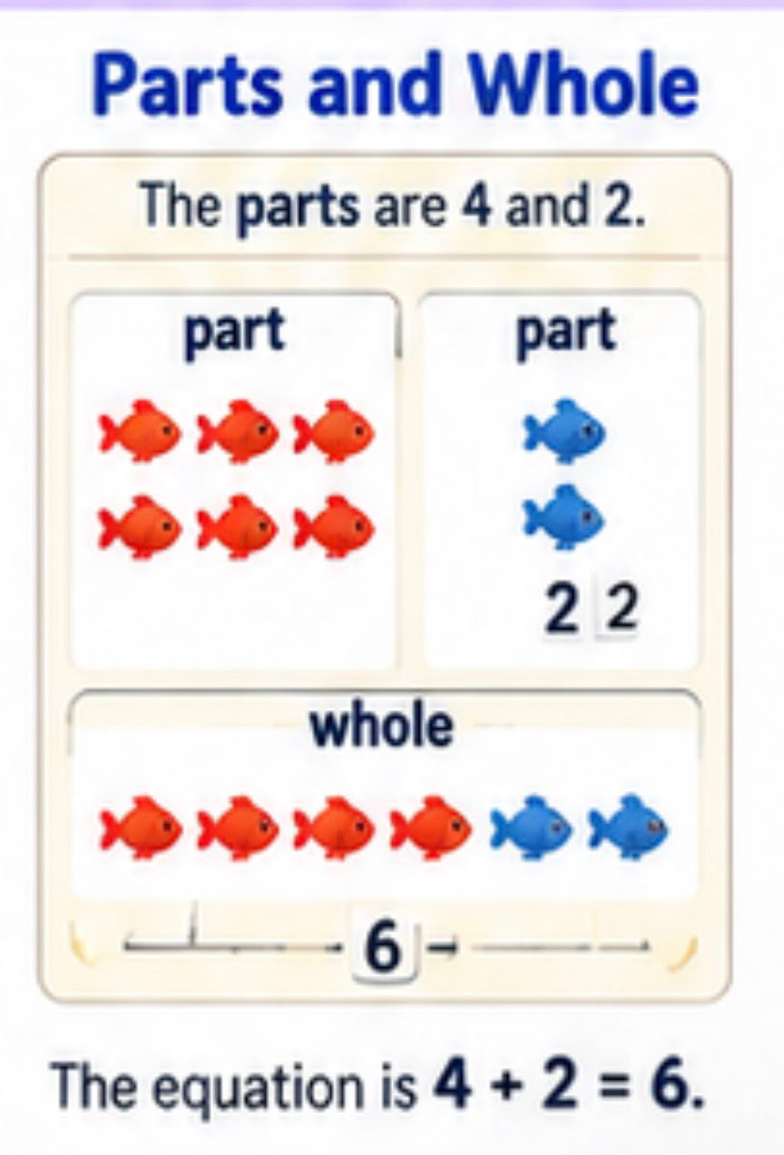
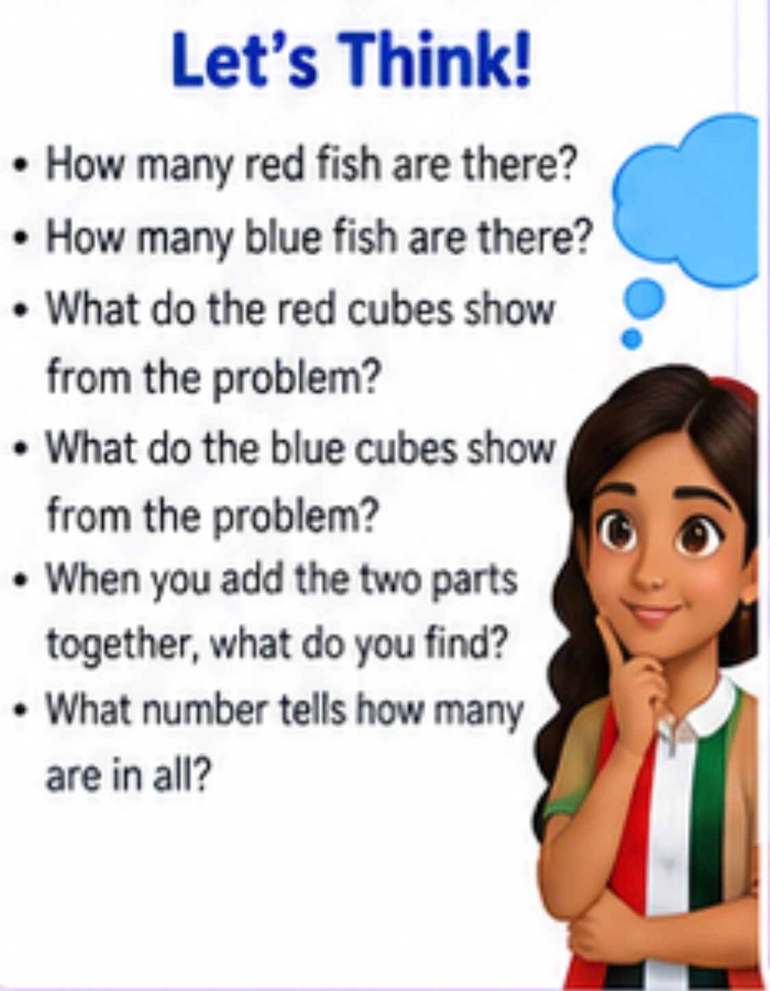


Slide 7
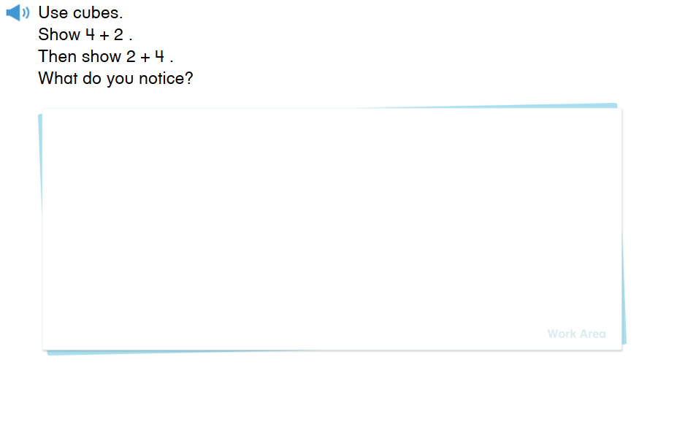
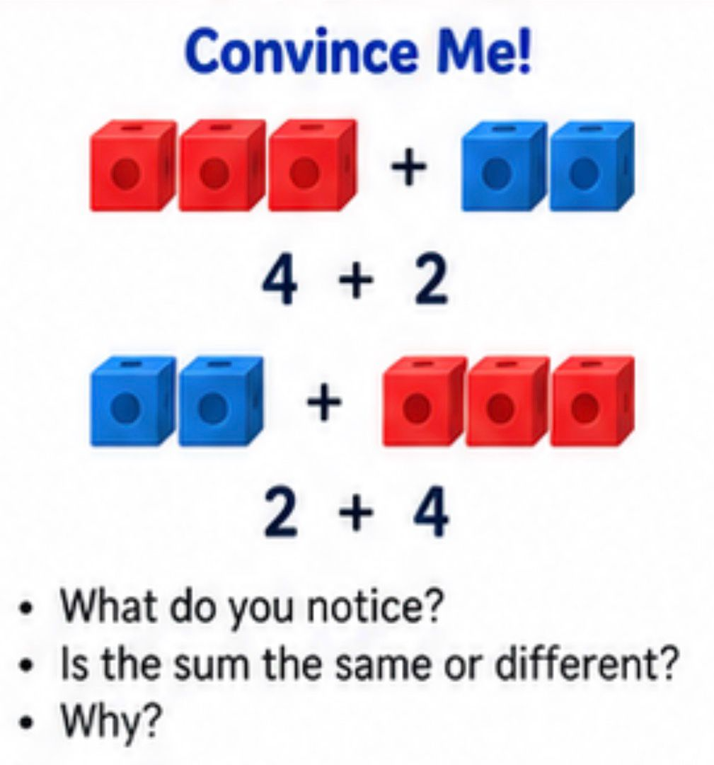
10 min
BUILD → TURN → COMPARE → EXPLAIN

Slide 8
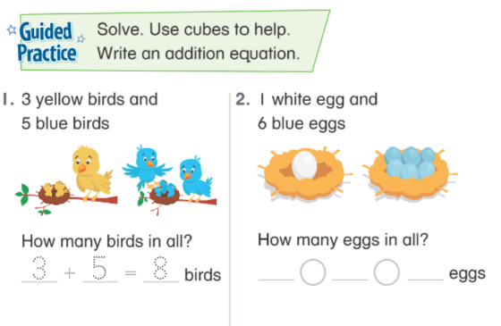
Guided Practice • Student Book p. 10 Date:07.09.2026
BUILD → WRITE → SAY
Look carefully at each group of objects.
Count the two parts how many are in each group?
Put the two parts together and write the addition equation.
Find and write the whole — how many are there in all?

Slide 9
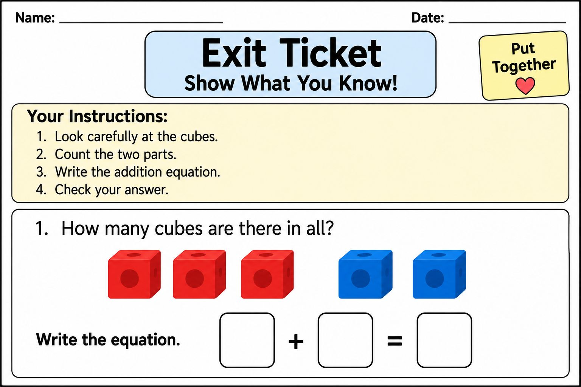
4 min
Exit Ticket
👀 Look carefully at the problem.
2. Count the two parts and identify the numbers.
3. Write the equation that shows the two parts put together.
4. Check your answer before you submit your work.

Slide 10

1:00 min

